Slide 1
WALL – E (Bot)
Pakiyalakshmi S (9923151063)
Rajapandi N (9923151070)

Slide 2
INTRODUCTION
Project WALL-E is an interactive application designed using Figma to provide a seamless and user-friendly interface. It integrates functionalities like PDF-to-text conversion, image-to-text extraction, image search, and multilingual voice-to-text translation.
Focused on accessibility and responsiveness, the project overcomes challenges like UI alignment and backend integration to deliver a versatile tool for dynamic multimedia interaction.

Slide 3
Project Scope
Core Features:
PDF-to-Text: Users can upload PDFs and extract the text easily.
Image-to-Text (OCR): Converts images into editable text.
Voice-to-Text: Converts audio into text, with multi-language support.
Image Search: Search images based on descriptive text input.

Slide 4
Objective Of Project WALL-E
The objective of Project WALL-E is to design and develop a multifunctional application that simplifies user interaction with digital content. By integrating features such as PDF-to-text conversion, image-to-text extraction, image search, and multilingual voice-to-text translation, the project aims to:
Enhance accessibility to diverse forms of information.
Provide a seamless, user-friendly interface for efficient data processing.
Ensure responsiveness and compatibility across devices for a consistent user experience.
Create a versatile platform that meets the needs of users in various fields requiring multimedia interaction.

Slide 5
Figma-Specific Tools
Design Tools:
Frame Tool: To create layouts for screens like login, signup, and home pages.
Components: For reusable UI elements like buttons, headers, and form fields.
Auto Layout: To ensure consistent spacing and alignment in your designs.
Prototyping: To connect screens and simulate interactions such as clicks and navigation.
Plugins:
Iconify: For adding icons to your design.
Content Reel: To fill forms with sample data like names, emails, or passwords.
Interactive Prototypes:
Use Figma’s Prototype Mode to simulate interactions such as button clicks, transitions, and hover effects.

Slide 6
WORKFLOW
Here I have mentioned one of the module’s work flow
Sample Workflow with Diagram
User Action: Login/Signup.
Navigation: User lands on the Home Page.
Feature Selection: User selects a feature (e.g., PDF-to-Text).
Upload: User uploads a file.
Processing: File is processed (simulated in the prototype).
Results Display: Extracted text or translated output is shown.
Next Action: User navigates to another feature or logs out.

Slide 7
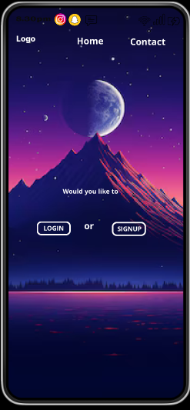
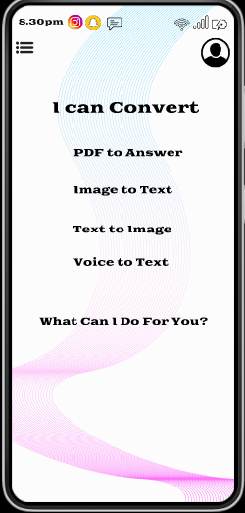
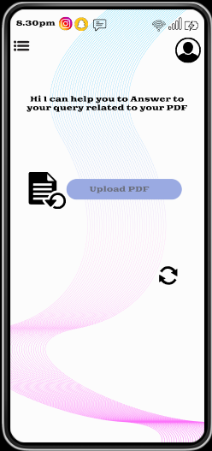
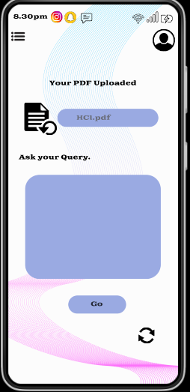
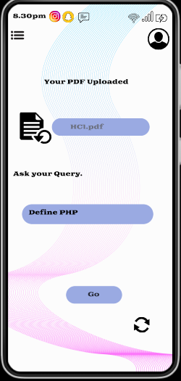
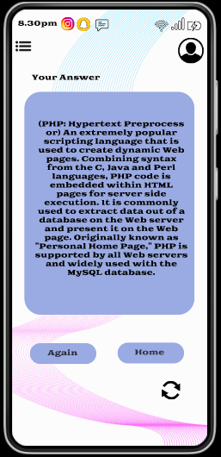
Sample Image For Work Flow
PDF to Text Convertor
Login/signup
Home Page
PDF update
Querying
Output

Slide 8
UI/UX Design Highlights
Design Focus: Clear, consistent navigation with well-defined buttons and input fields.
Aesthetic Design: Modern, clean layout with a user-friendly interface to avoid overwhelming the user.
Responsiveness: Design adapts well to screen sizes (mobile).

Slide 9
Accessibility Considerations
Multilingual Support: Voice-to-text and text-based features.
Visual Accessibility: High-contrast text, scalable fonts, and easy navigation.
User-Friendly Interface: Simplified layout with clear instructions and actionable buttons.

Slide 10
Benefits of the Project
User-Centric Design: Focus on simplicity, accessibility, and ease of use.
All-in-One Interface: Multiple functionalities combined into a single platform.
Global Reach: Multilingual support for wider accessibility.
Future-Ready: Scalable for future updates and integration with backend functionalities (e.g., AI-based features).

Slide 11
Conclusion
The WALL-E project successfully integrates multiple features like PDF-to-text, image-to-text, voice-to-text, and image search into a user-friendly, responsive UI/UX design created in Figma. It focuses on providing an intuitive, accessible experience, making it easier for users to interact with digital content. The design is scalable, multilingual, and visually accessible, ensuring it meets a wide range of user needs. Future improvements can include backend integration and AI-powered features to enhance functionality.

Slide 12
Thank You.

